Slide 2
ACCESS

Slide 3
UCF
Orlando, FL
Metropolitan, suburban university
64,000+ students
One of the largest universities in U.S.
Carnegie classification: RU/VH Research University: Very High Research Activity
216 degree programs across 11 colleges
11 Campuses throughout Central Florida

Slide 4
Academic Year 2016-2017
42.2% total university SCH online/blended
32.5% fully online SCH
81% of all students took at least one online/blended course
83.7% of all undergraduates
62.8% of all graduate students
72% of all students took at least one fully online course
74.9% of all undergraduates
52.6% of all graduate students
Notes:
SCH = Semester Credit Hours

Slide 5
Academic Year 2016-2017
Colleges over 50% online SCH
Nursing
63.5% | 48% online only
Health & Public Affairs
62.9% | 53.4% online only
Hospitality
62% | 18.4% online only
Business
58.9% | (<.01 blended)
Colleges over 25% online SCH
Undergrad Studies
47.2% | 33.4% online only
Arts and Humanities
47.1% | 36.6% online only
Graduate Studies
42.1% | 16.4% online only
Sciences
34.5% | 23.9% online only
Education
31.3% | 18.6% online only

Slide 6
UCF Today: 64,300+ Students
6
Notes:
Video = Lecture Capture

Slide 7
Without Online Learning: 40,000 Students

Slide 8
Online Exclusive Headcount by Semester
8

Slide 9
21 Online Undergraduate Programs (State colleges and select out-of-state partners)
Non Market-Rate Graduate Degrees and Certificates (Promote 2+2+2 online pathways)
National Market-Rate Graduate Programs (Example: Master of Social Work)
Reduced Fees for online students

Slide 10
UCF Online TransferConnect State College Partners
Miami-Dade College
Key West Community College
Polk State College
Indian River State College
Pasco-Hernando State College
Florida Gateway College
Pending
North Florida Community College
Northwest Florida State College

Slide 11
Fully Online Students in Online Programs

Slide 12
QUALITY

Slide 13
Student Success
(A, B, or C grade)
Percent
13

Slide 14
Student Withdrawal
Percent

Slide 15
Overall “Excellent” Student Ratings
N = 1,431,907
Blended Learning 57%
Fully Online 55%
Face-to-Face 53%
Video (fully online) 47%
Video (blended) 45%
– Dziuban & Moskal, 2017

Slide 16
A decision rule for the probability of faculty member receiving an overall rating of Excellent
If...
Very
Excellent Good Good Fair Poor
Helping Achieve Course Objectives
Communicating Ideas And/or Information
Then...
The probability of an overall rating of Excellent = .92 &
The probability of an overall rating of Fair or Poor ≈ .00
(Rule N=85,157)
(N=1,431,907)

Slide 17
A comparison of excellent ratings by course modality--unadjusted and adjusted for instructors satisfying the Rule
Course Overall If Rule
Modality % Excellent % Excellent
Blended 57 91
Online 55 93
Face-to-face 53 91
Lecture capture 47 89
Blended LC 45 89
(N=1,431,907)
Notes:
If Rule from previous slide

Slide 18
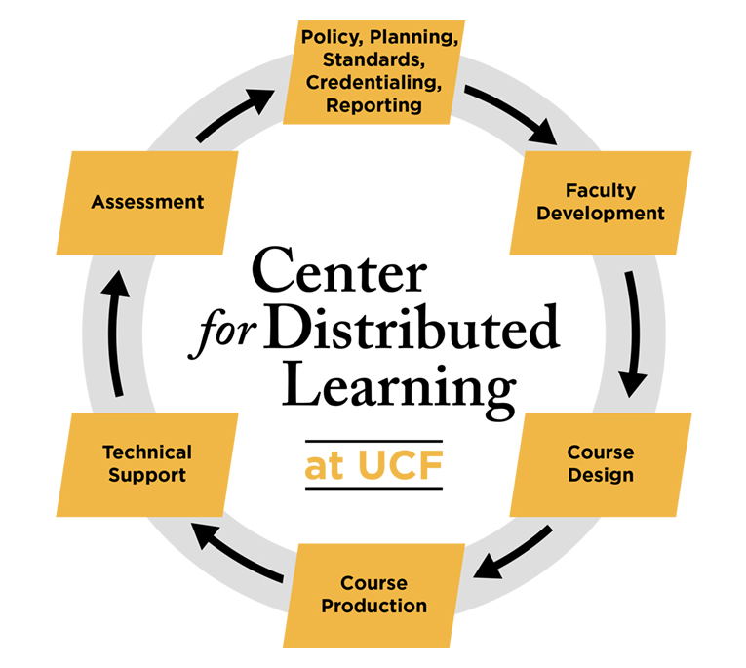

Slide 19
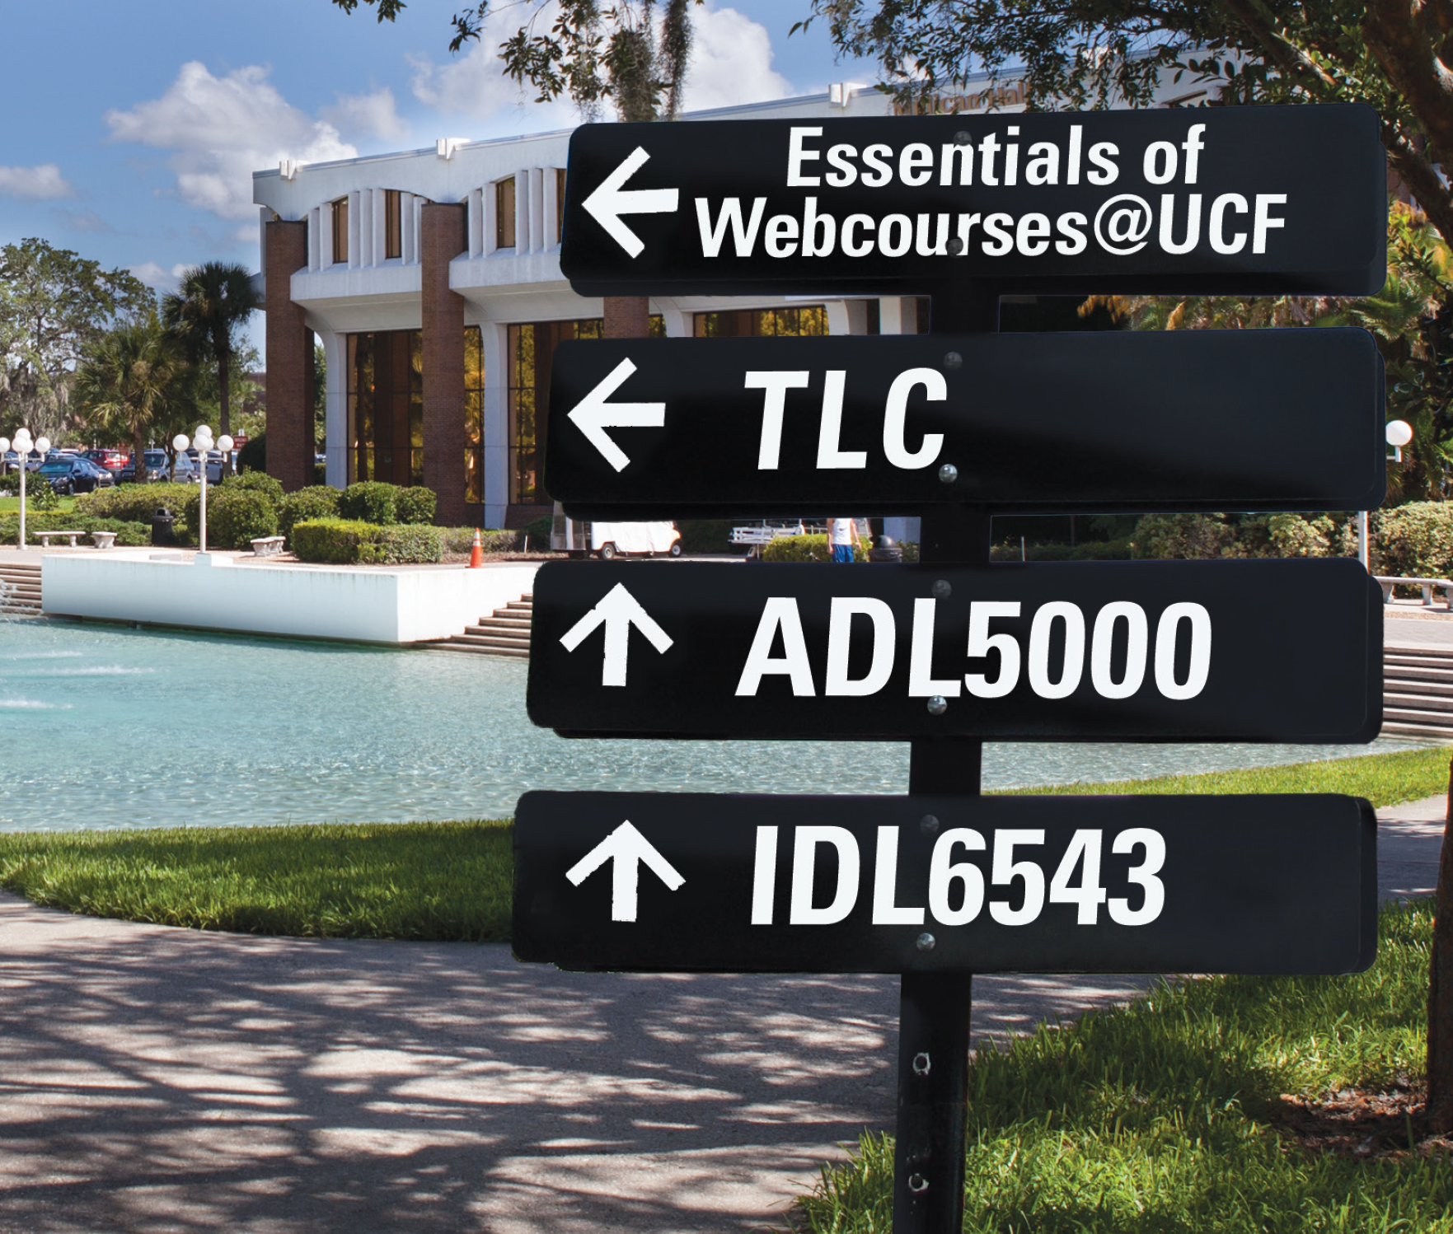
Faculty Development

Slide 21
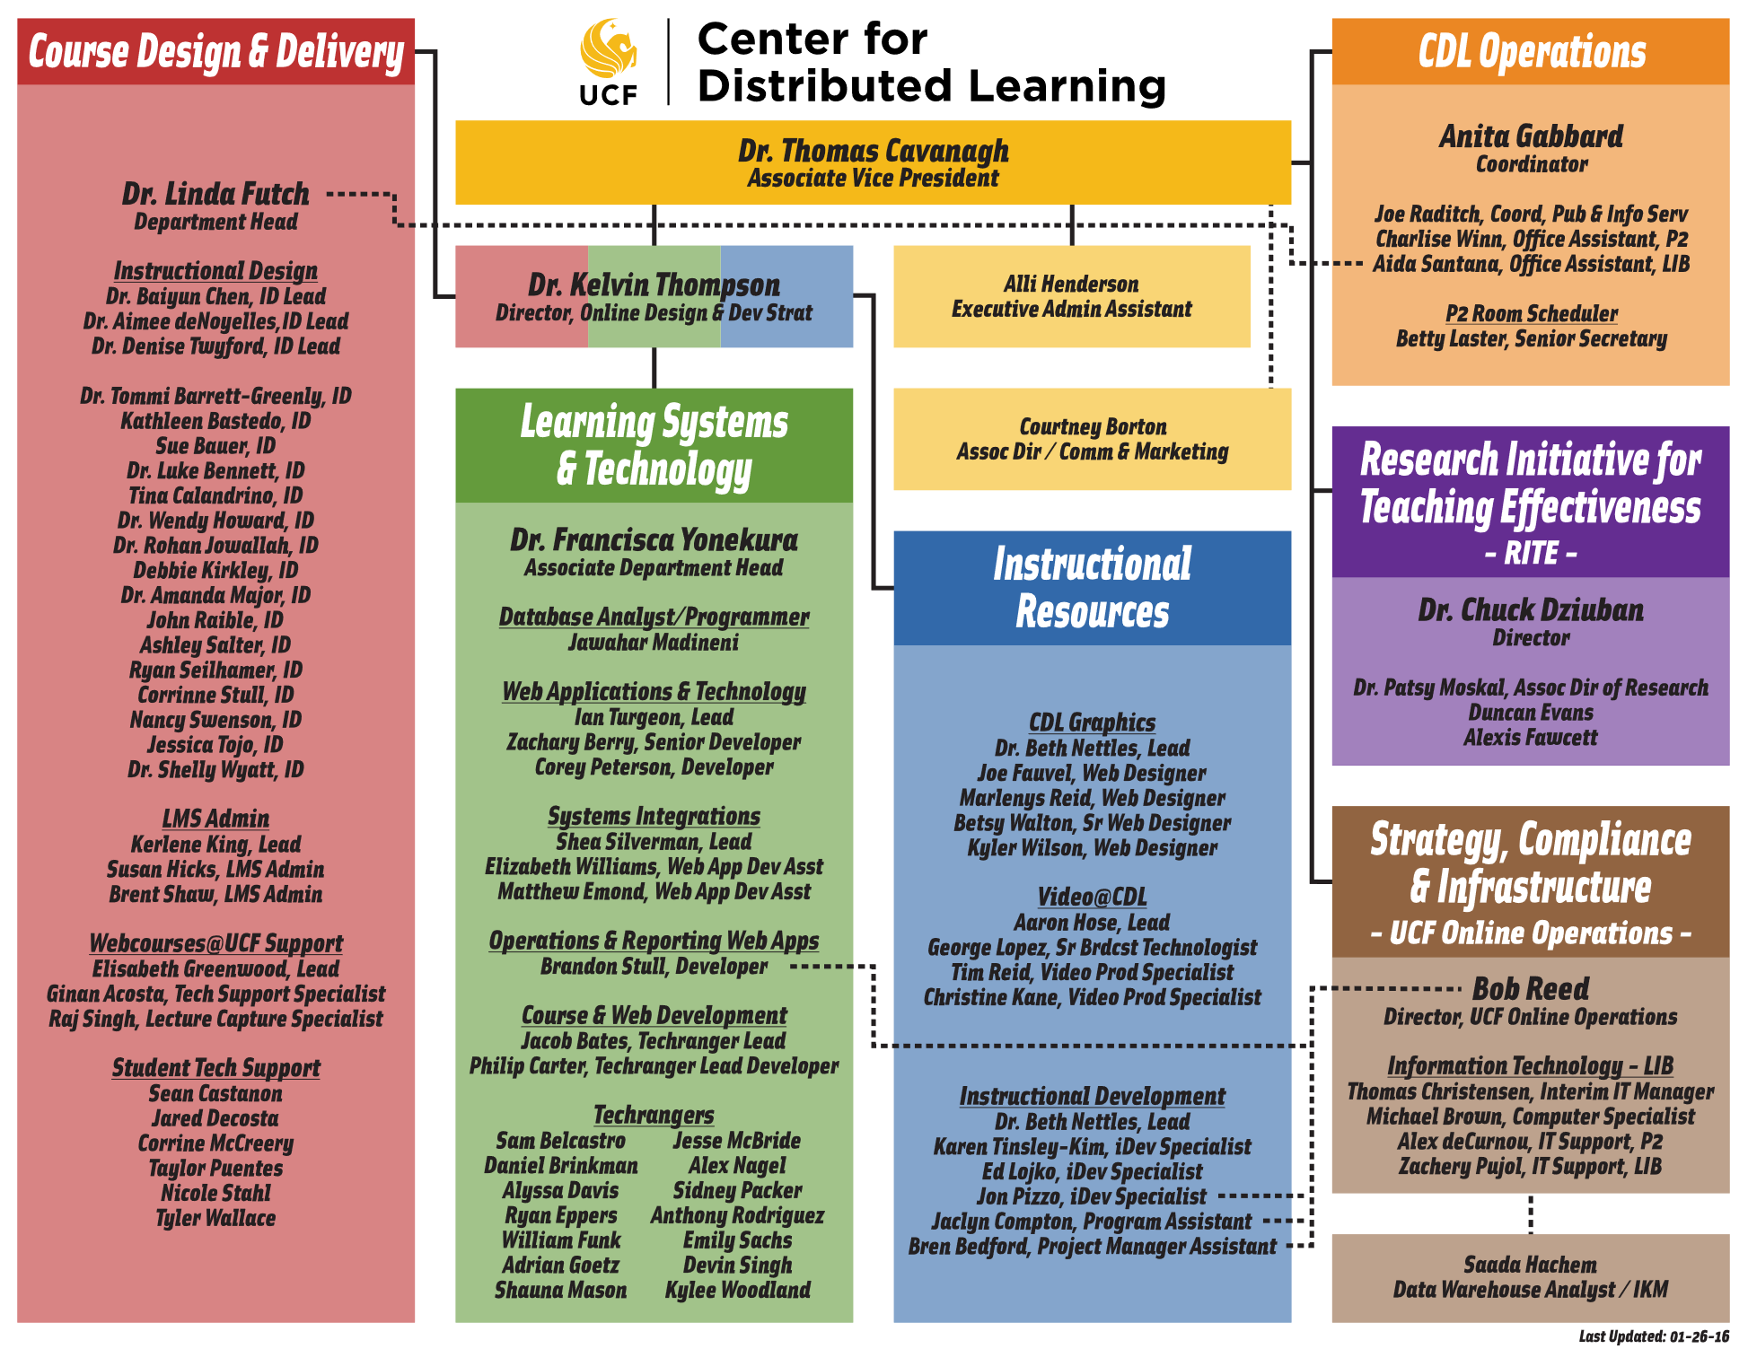

Slide 22
AFFORDABILITY

Slide 23
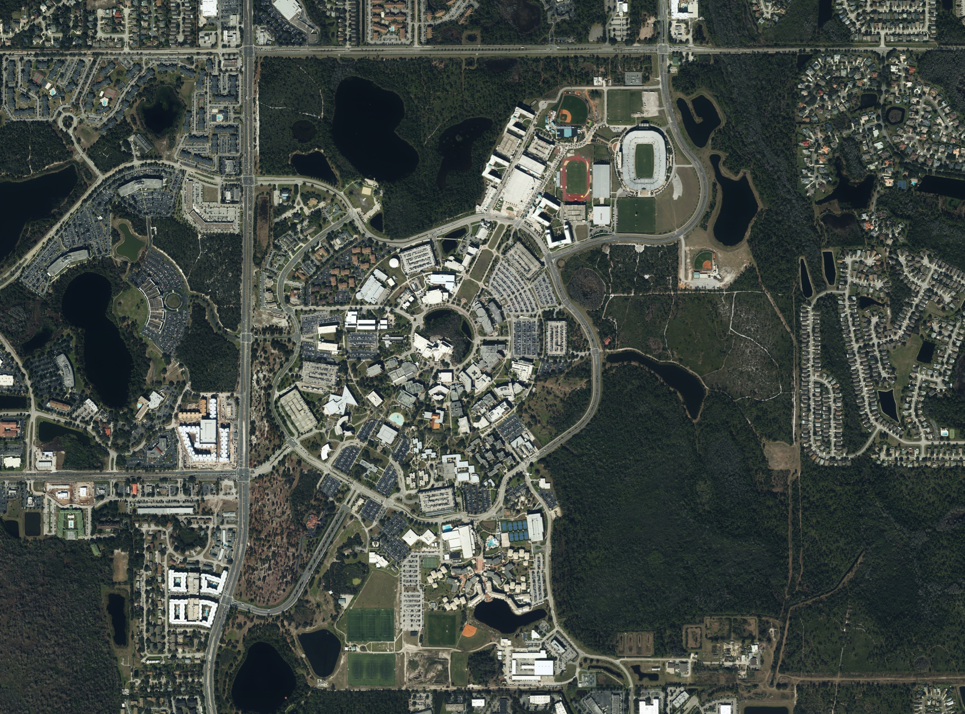

Slide 24
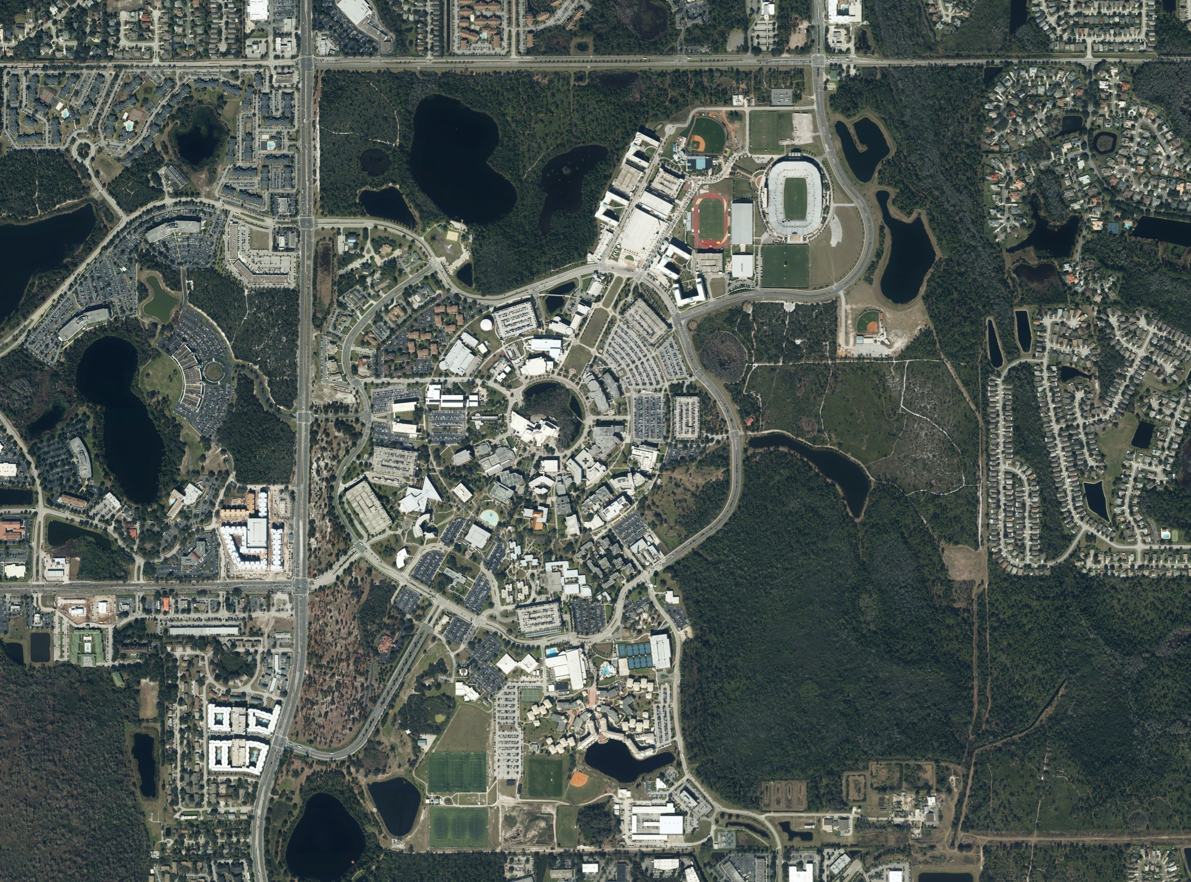
$192 M
$7.2 M
Notes:
Top: Cost to build classroom space without online / hybrid modalities
Bottom: Annual maintenance costs for those facilities

Slide 25
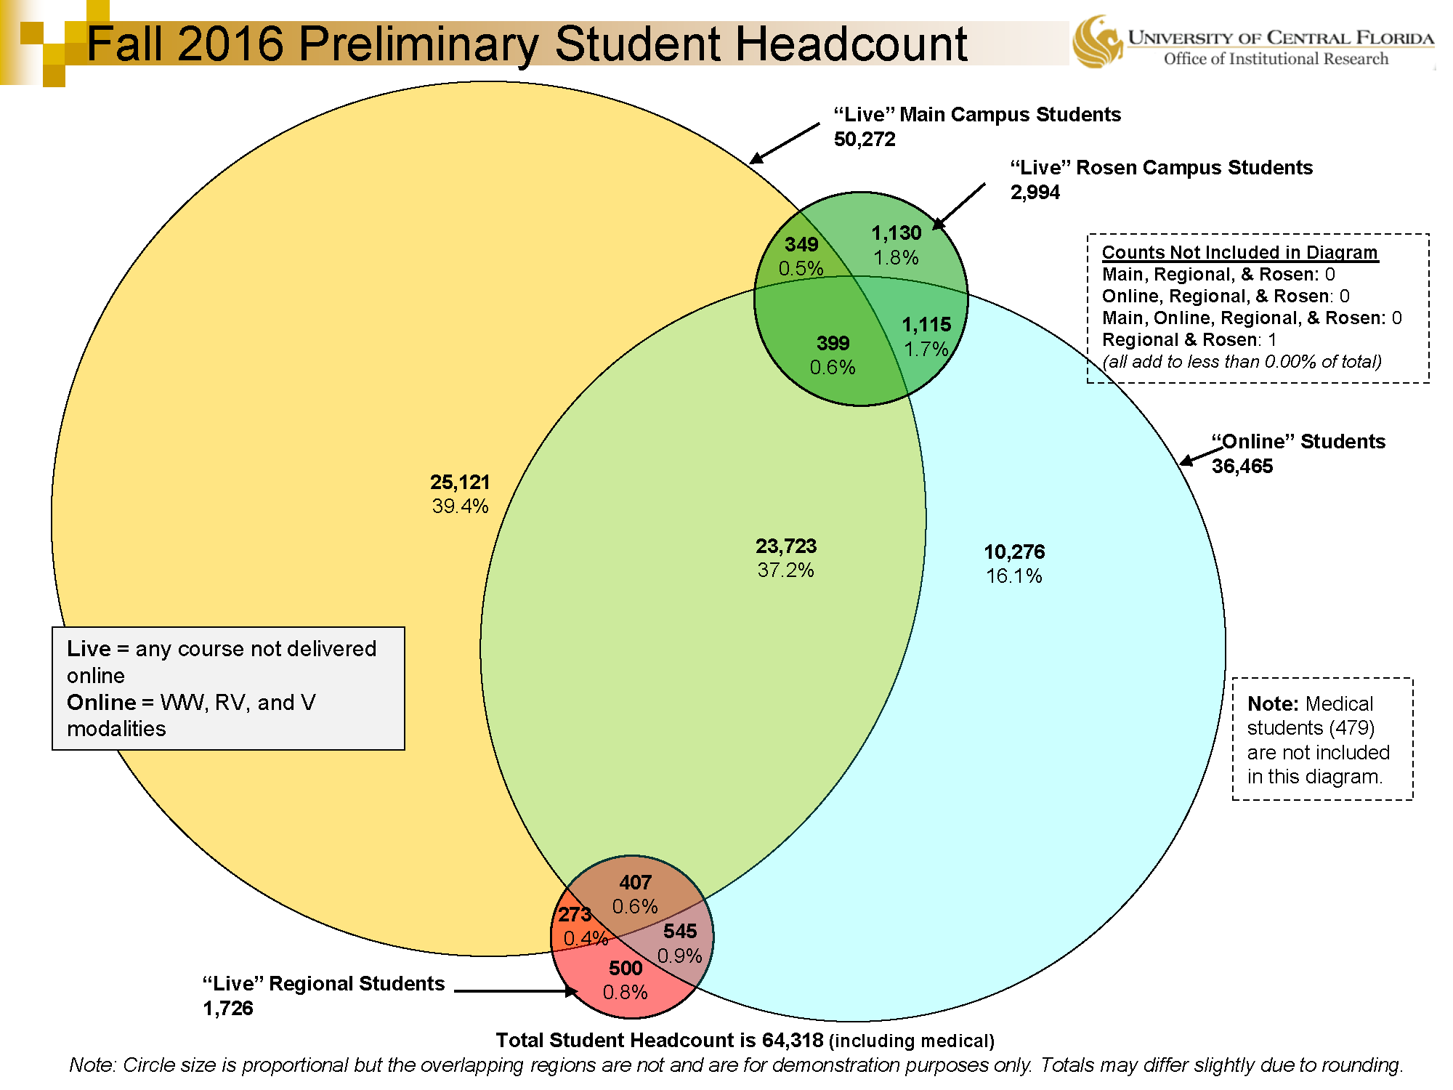
Notes:
Modalities explained: https://cdl.ucf.edu/support/student/modalities/

Slide 26
Online % and Speed to Graduation (FTIC Full-time)
N=0
N=5
N=30
N=381
N=1,556
N=2,155
N=231

Slide 28
Technical Integrations
UDOIT
Student Performance Dashboard
Quiz Moderator
Due Date Changer
Proctorhub
Obojobo
Materia
Others

Slide 29
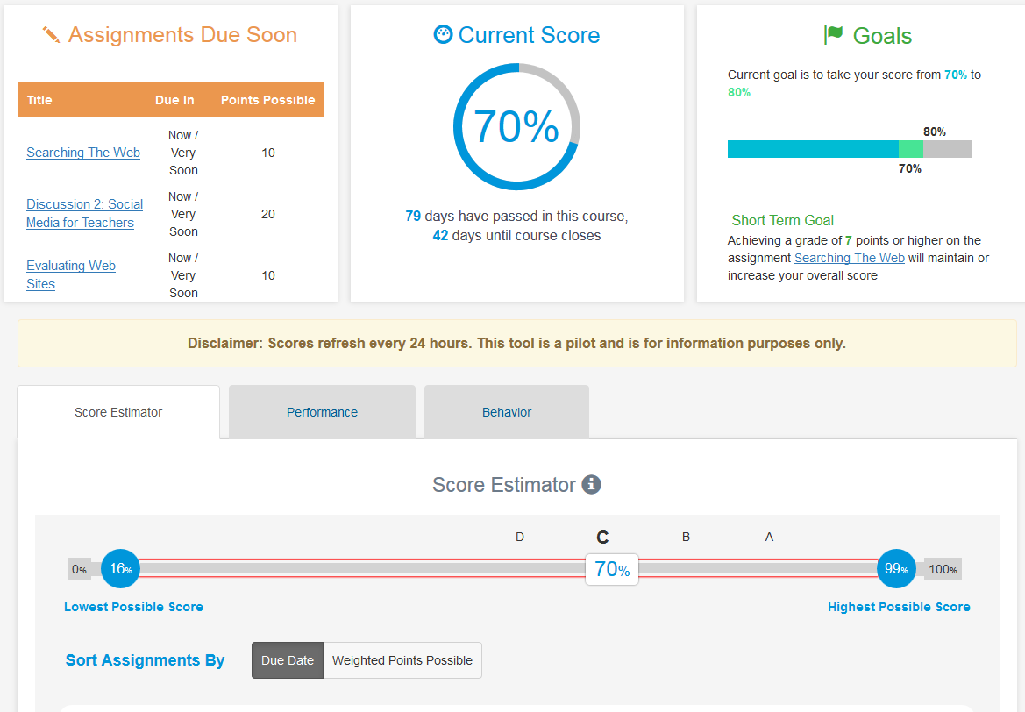
Student Performance Dashboard
https://lti.online.ucf.edu/spd-standalone/

Slide 30
Personalized Adaptive Learning
Math
CWiC evaluation
Educational Research
Nursing
Psychology
Others
Moving from pilot to strategy
DFW, gateway courses, success marker courses

Slide 31
Reduced Seat Time Adaptive
Planned pilot
3 courses in Fall 2017

Slide 32
Adaptive Research
UCF research
Student survey
Analytics
Student success
Collaborative research (CTU, Baypath, APUS)
Results that can be applied to other schools

Slide 33
Student Survey Collaboration (UCF-CTU): Students who would take another adaptive learning course
P=.01

Slide 34
Psychology: Mean Module Scores by Course Success
Success
(n=258)
Non-success
(n=20)

Slide 35
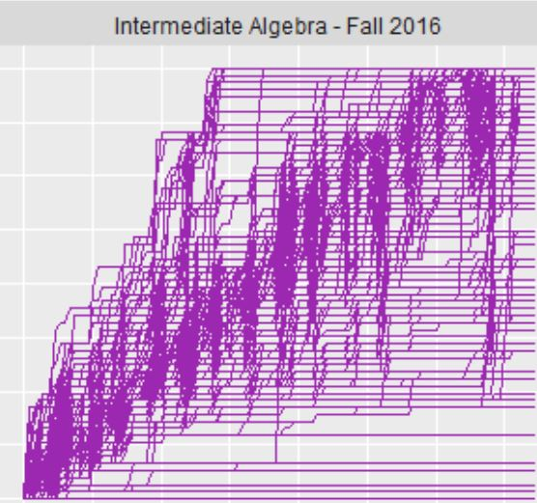
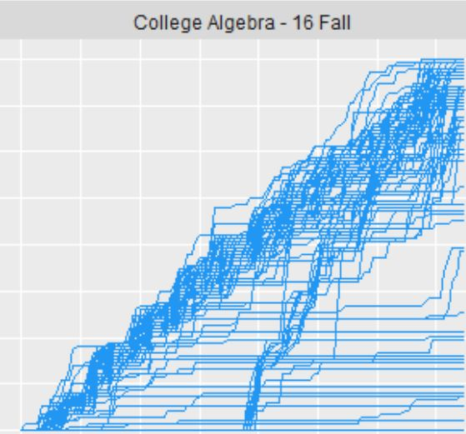
Math Sequence: Adaptive Learning Across Courses
Finished course early
Started late and finished on time
Knowledge Covered
Knowledge Covered
Days
Days

Slide 36
Online College Algebra:
Success Rates by Semester
Realizeit Redesign
Percent
Semesters Offered

Slide 37
DISCUSSION

Slide 38
Thomas Cavanagh
cavanagh@ucf.edu
@tbcavanagh
cdl.ucf.edu | ucf.edu/online

